Slide 1
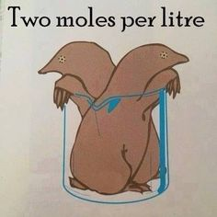

Slide 2
A2 Chemistry
Concentration

Slide 3
Review
Solutions are homogeneous mixtures of a solute dissolved in a solvent; they can be unsaturated, saturated or supersaturated

Slide 5
Learning Intention
the concentration of a solution is defined as the quantity of solute dissolved in a quantity of solution; this can be represented in a variety of ways, including by the number of moles of the solute per litre of solution (mol L⁻¹) and the mass of the solute per litre of solution (g L⁻¹) or parts per million (ppm)

Slide 6
Success Criteria
Given mass of solute and mass, volume and/or density of solvent or solution, determine concentration in gL⁻¹, mol L⁻¹, % or ppm
Classify as unsaturated, saturated or supersaturated based on solubility data.

Slide 7
Concentration
The quantity of solute dissolved in a quantity of solution

Slide 8
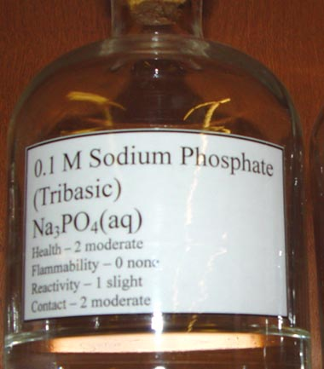
mol L⁻¹ (M)
Moles of solute per litre of solution
C = n
V
n = number of moles
V = volume in L

Slide 9
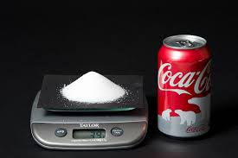
g L⁻¹
Mass of solute per litre of solution
C = m
V
m = mass of solute in g
V = volume in L

Slide 10
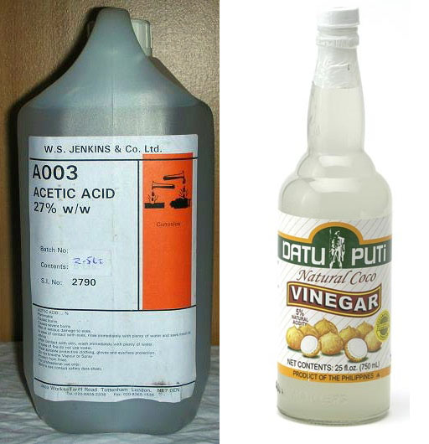
%
% by mass (w/w)
% w/w = mass of solute (g) x 100
mass of solution (g)
You may need to calculate mass of solution from density and volume

Slide 11
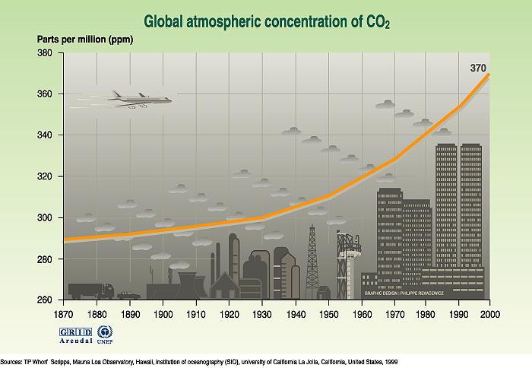
ppm
Parts per million (by mass)
Literally milligram of solute per kilogram of solution
ppm = mg of solute
kg of solution

Slide 12
